Slide 1
Introduction to Modern Controls
Introduction
Overview

Slide 2
The power of controls
Our internal body temperature is regulated around 37◦ C or 98.6◦ F, whether in a sauna room or outside at the north pole.
The power of feedback controls: it allows us to make a precision device out of a crude one that works well even in changing environments.
We also use prediction and feedforward controls: as kids, we had learned to wear T-shirts in summer, long sleeves and coats in winter. With such predictive and feedforward controls, the burden of feedback control is greatly lifted.
Overview

Slide 3
Analysis and control of linear dynamic systems
System: an interconnection of elements and devices for a desired purpose
Control System: an interconnection of components forming a system configuration that will provide a desired response
Feedback: the use of information of the past or the present to influence behaviors of a system
Overview

Slide 4
Why automatic control?
A system can be either manually or automatically controlled. Why automatic control?
Stability/Safety: diﬀicult/impossible for humans to control the process or would expose humans to risk
Performance: cannot be done “as well” by humans Cost: Humans are more expensive and can get bored
Robustness: can deliver the requisite performance even if process behaves slightly differently
Overview

Slide 5
Terminologies
Disturbance
Plant
Reference
Output
Input filter
+
Actuator
Process
Controller
−
Sensor
Sensor noise Process: whose output(s) is/are to be controlled
Actuator: device to influence the controlled variable of the process Plant: process + actuator
Block diagram: visualizes system structure and the flow information in control systems
Overview

Slide 6
Open-loop control v.s. closed-loop control
Disturbance
Desired Output
u(t)
y(t)
Controller |  | Controlled System
the output of the plant does not influence the input to the controller
input and output as signals: functions of time, e.g., speed of a car, temperature in a room, voltage applied to a motor, price of a stock, electrical-cardiograph, all as functions of time.
Overview

Slide 7
Open-loop control v.s. closed-loop control
Heat Loss
Desired T
−
Room T
Thermostat
Gas Valve
Furnace
House
+
multiple components (plant, controller, etc) have a closed interconnection
there is always feedback in a closed-loop system
Overview

Slide 8
Closed-loop control: regulation example
Heat Loss
Desired T
−
Room T
Thermostat
Gas Valve
Furnace
House
+
Overview

Slide 9
Regulation control example: automobile cruise control
Road Grade
Desired Speed Controller
Actual Speed
??
Auto Body
Throttle ^{Engine}
Measured Speed
Speedometer
What is the control objective?
What are the process, process output, actuator, sensor, reference, and disturbance?
Overview

Slide 10
Control objectives
Better stability
Improved response characteristics
Regulation of output in the presence of disturbances and noises Robustness to plant uncertainties
Tracking time varying desired output
There are some aspects of control objectives that are universal. For example, we would always want our control system to result in closed-loop dynamics that are insensitive to disturbances. This is the disturbance rejection problem. Also, as pointed out previously, we would want the controller to be robust to plant modeling errors.
Overview

Slide 11
Means to achieve the control objectives
Model the controlled plant
Analyze the characteristics of the plant Design control algorithms (controllers)
Analyze performance and robustness of the control system Implement the controller
Overview

Slide 12
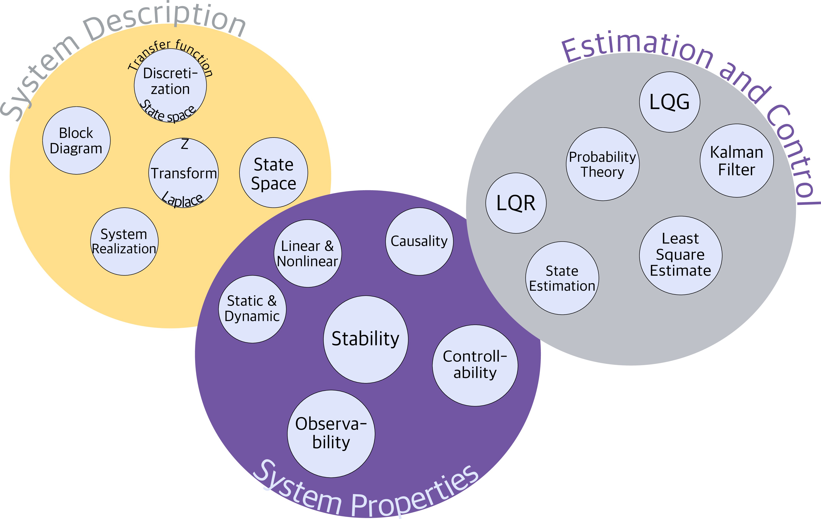
About this course
a first-year graduate course on modern control systems
a prerequisite to most advanced control courses
Overview

Slide 13
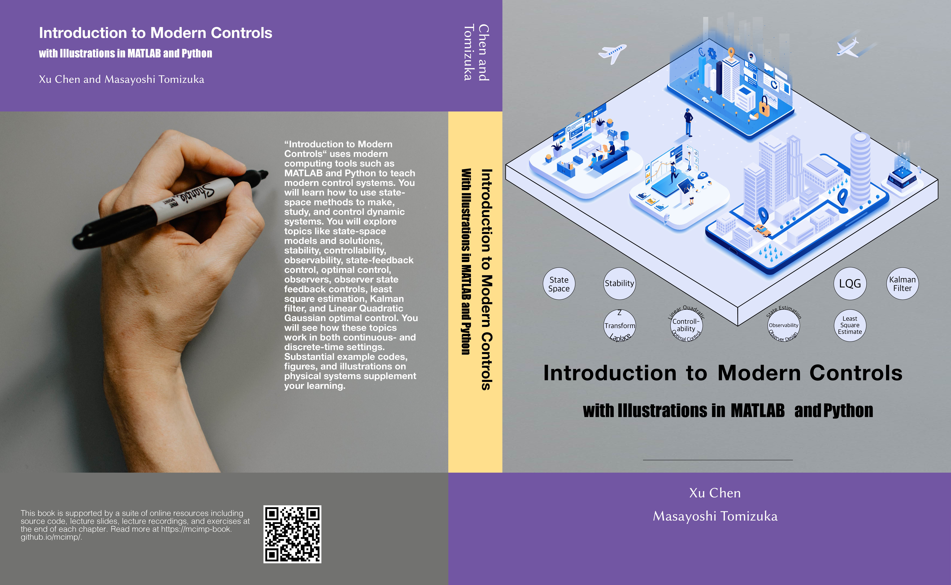
Textbook
Overview

Slide 14
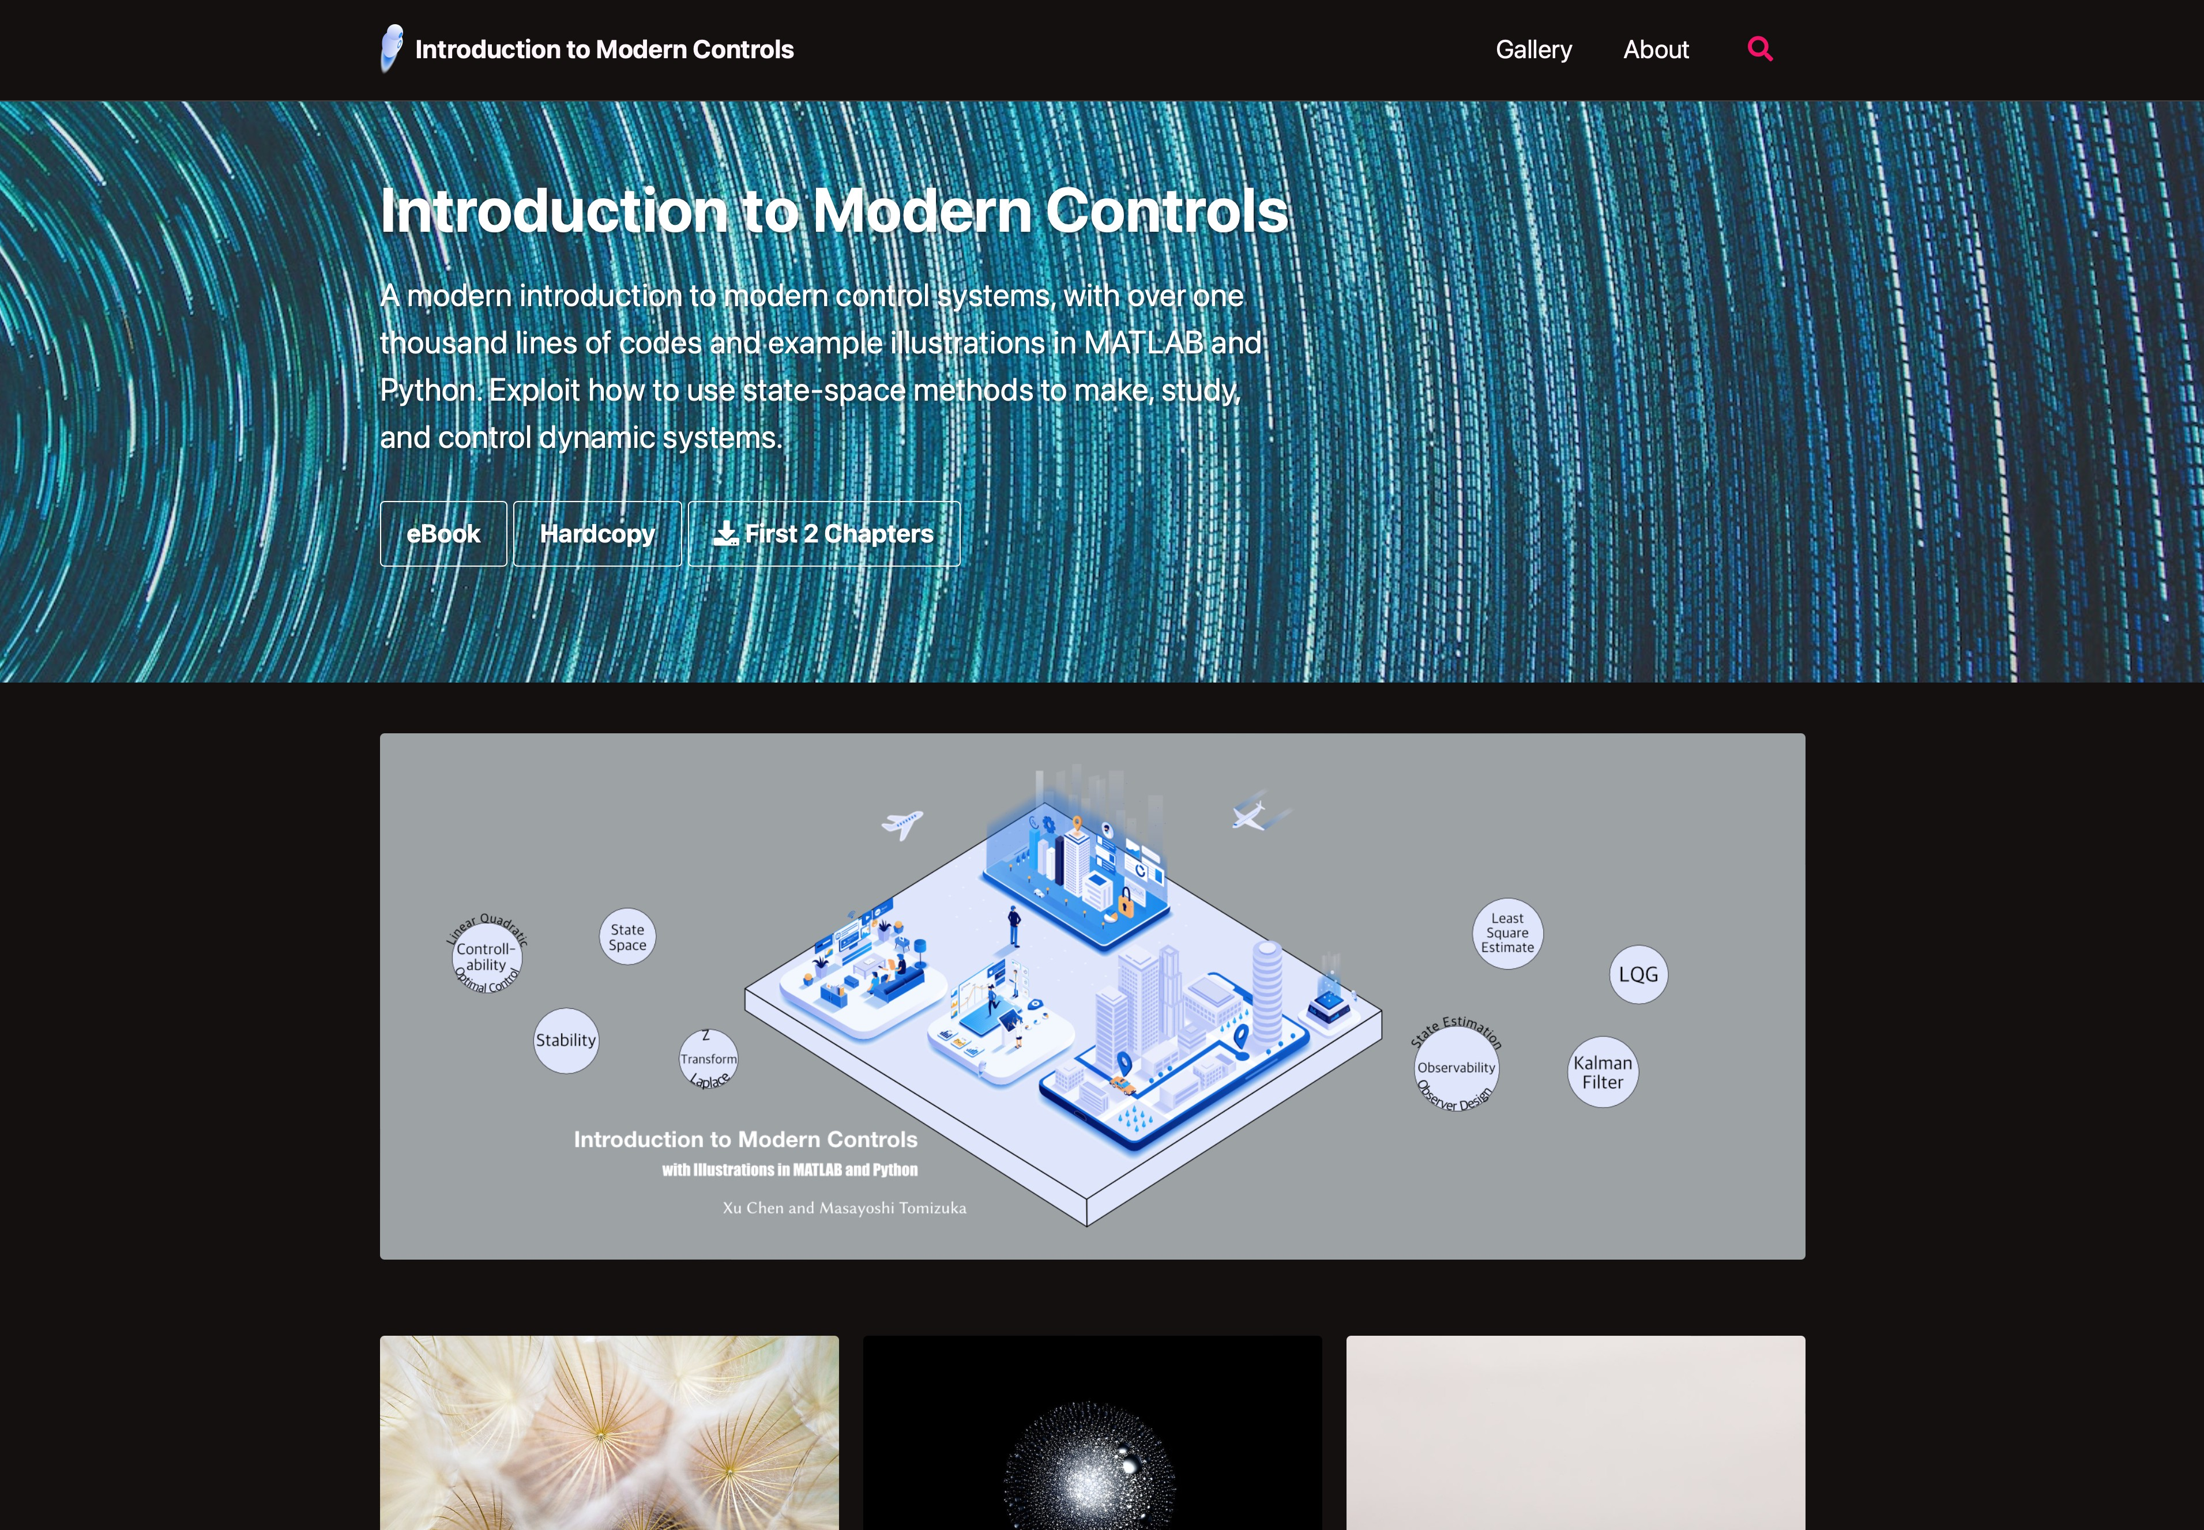
Textbook
Overview

Slide 15
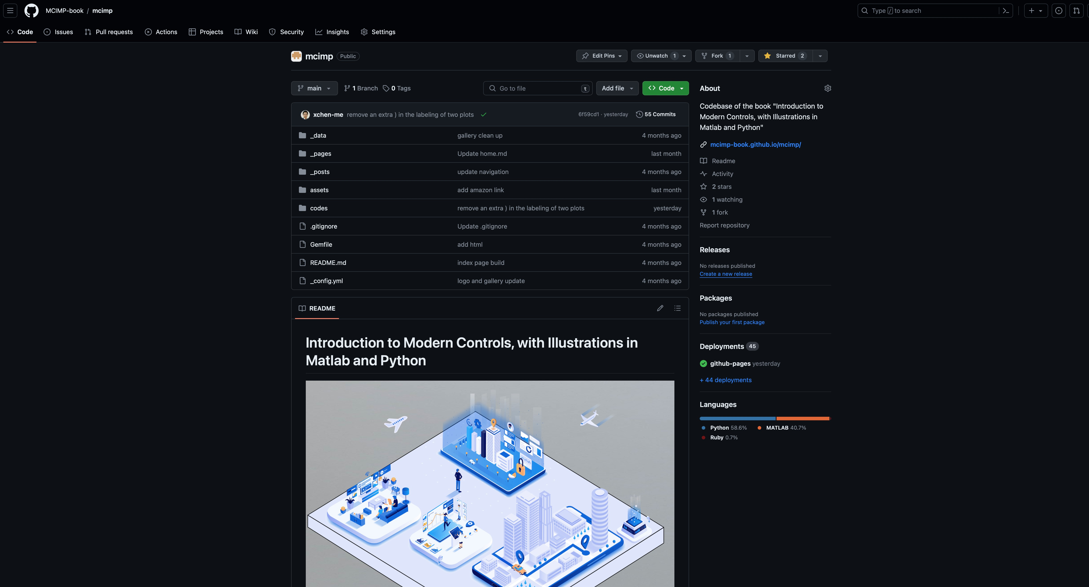
Textbook
Overview

Slide 16
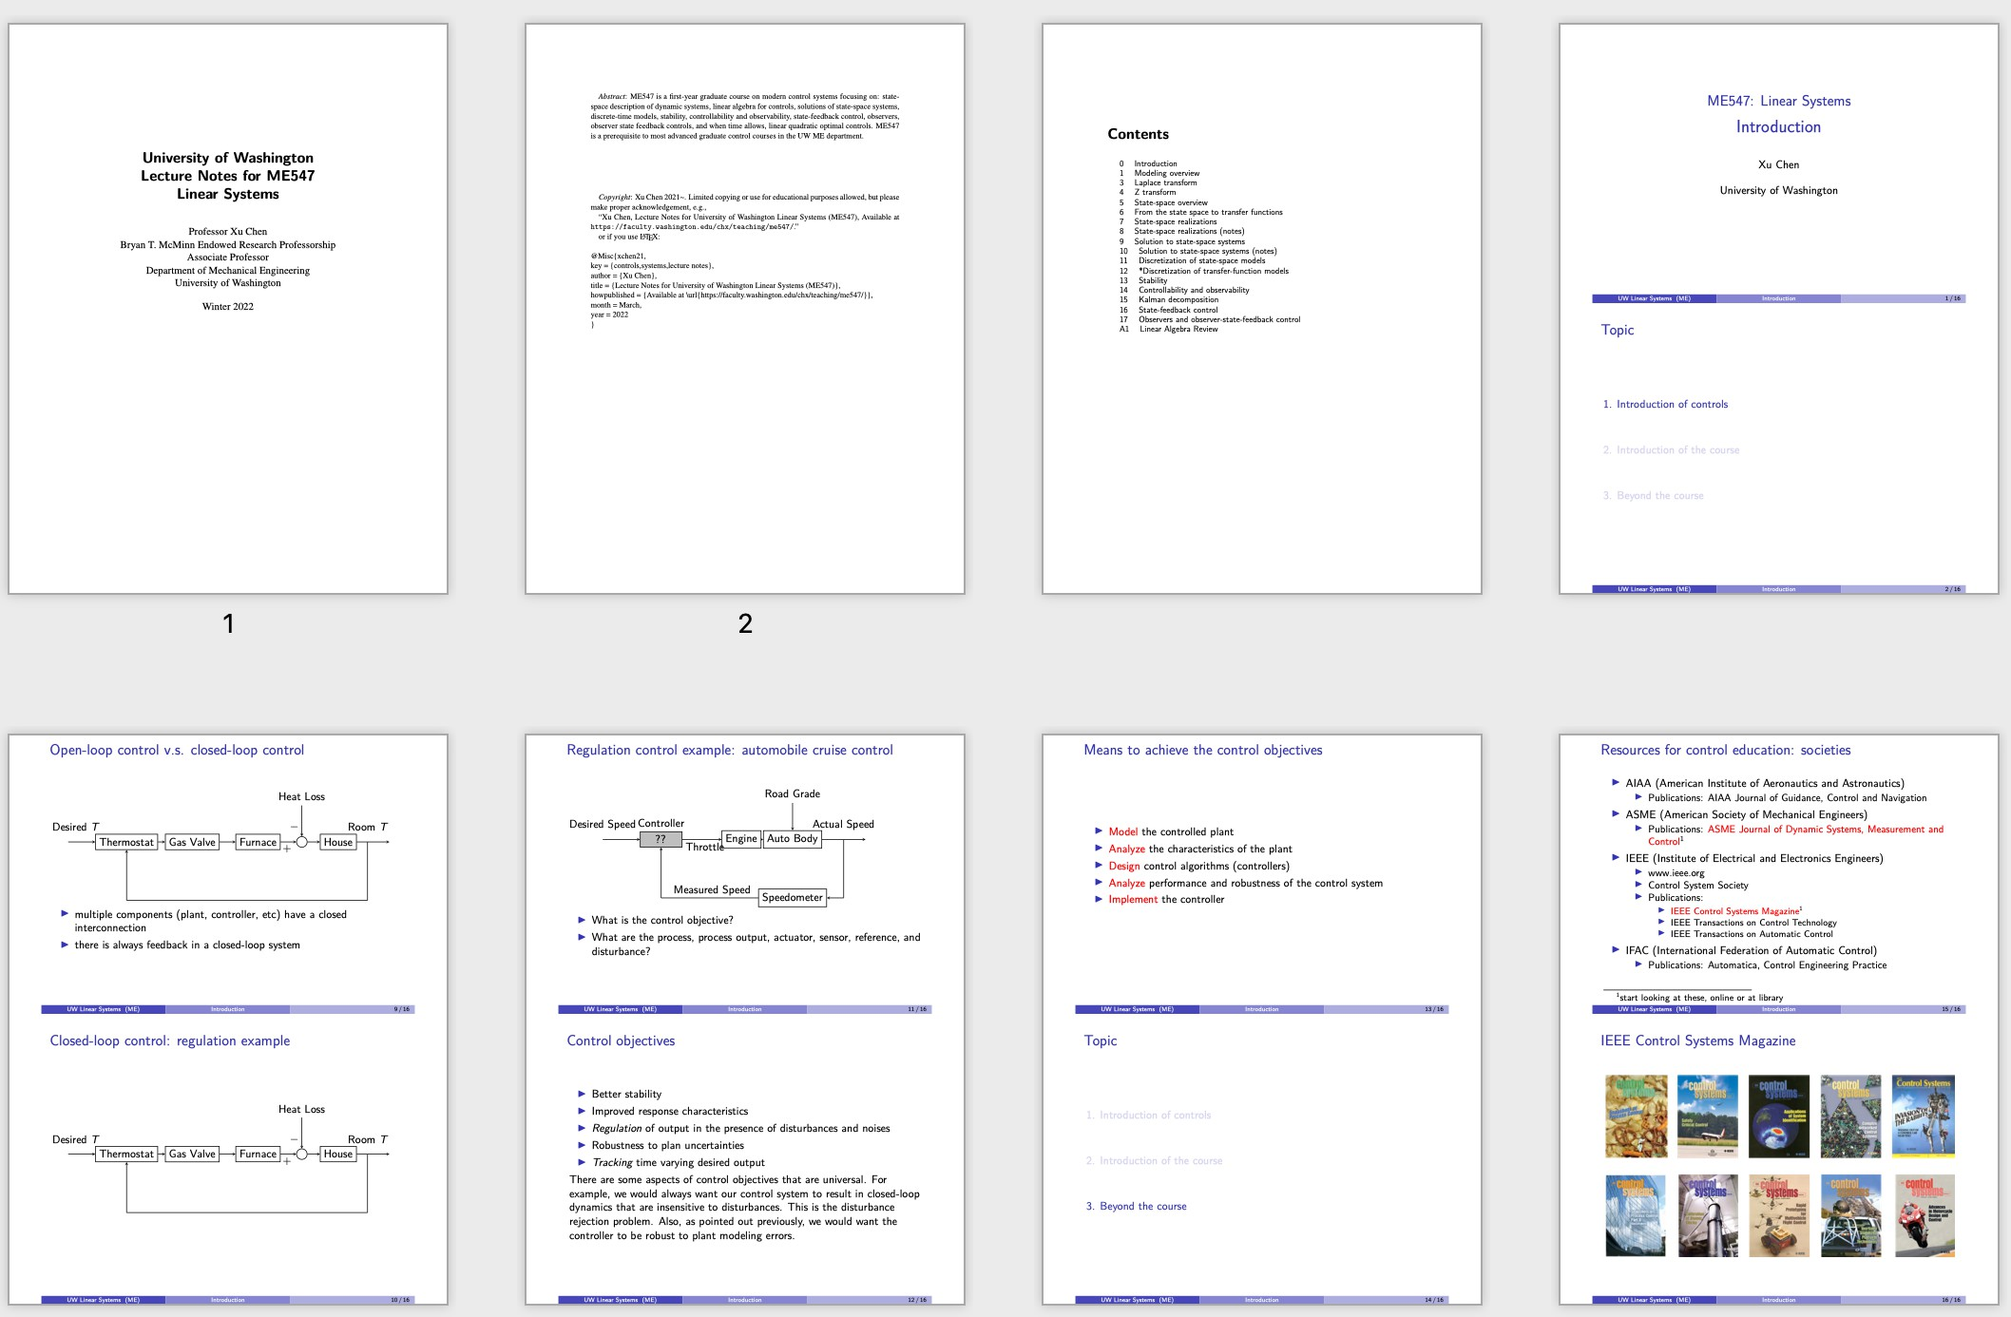
Written materials
Open-source Course Notes
Overview

Slide 17
Resources for control education: societies
AIAA (American Institute of Aeronautics and Astronautics)
▶ Publications: AIAA Journal of Guidance, Control and Navigation
ASME (American Society of Mechanical Engineers)
▶ Publications: ASME Journal of Dynamic Systems, Measurement and Control¹
IEEE (Institute of Electrical and Electronics Engineers)
▶ www.ieee.org
▶ Control System Society
▶ Publications:
⋆ IEEE Control Systems Magazine¹
⋆ IEEE Transactions on Control Technology
⋆ IEEE Transactions on Automatic Control
IFAC (International Federation of Automatic Control)
▶ Publications: Automatica, Control Engineering Practice
¹start looking at these, online or at library
Overview

Slide 18
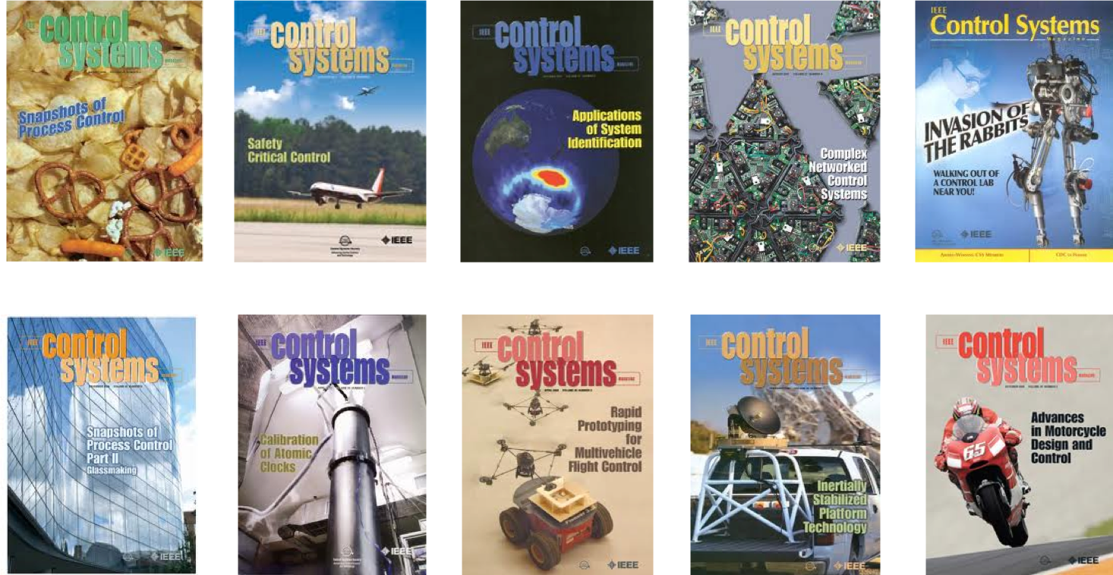
IEEE Control Systems Magazine
Overview

